Slide 1
Privacy Mediators: Helping IoT Cross the Chasm

Slide 2
Agenda
Introduction
Privacy Control Requirements
Architectural Approach
Business Models
Challenging Use Cases
Related Work
Conclusion

Slide 3
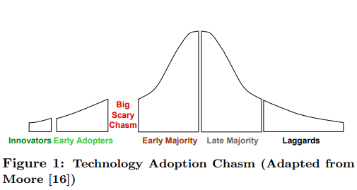
“Crossing the Chasm”
78% of consumers are highly concerned about companies selling their data to third parties
Pervasiving across all age groups, including millennials
Notes:
Millennials Y 世代，80后+90后

Slide 4
Privacy Control Requirements
“I should get to decide how much of my data a service or application gets to see”
“I should get to decide who my data is shared with”
“A camera on every human body, in every room, on every street, and in every vehicle”

Slide 5
Users should be able to control the release of their own data.

Slide 6
Privacy Control Requirements
Deletion and denaturing
Summarization
Inference
Anonymization
Mobility
Ease of Use

Slide 7
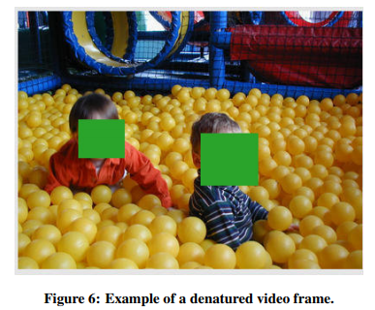
Privacy Control Requirements
Deletion and denaturing
Summarization
Inference
Anonymization
Mobility
Ease of Use
Notes:
如圖就是denaturing，具體請問下一組。

Slide 8
Privacy Control Requirements
Deletion and denaturing
Summarization
Inference
Anonymization
Mobility
Ease of Use
Temporal summaries:
Heartbeat counts
Spatial summaries
GPS to Zip code
Notes:
把一些數據總結一下發出來，例如最高心率，或者用郵編來代替gps位置。

Slide 9
Privacy Control Requirements
Deletion and denaturing
Summarization
Inference
Virtual sensor
Anonymization
Mobility
Ease of Use
Notes:
有的時候傳感器本身並不會暴露隱私，例如房間中的溫度啊，光照啊。但是依靠這個，我們就可以寫個程式來判斷房間里有沒有人。例如晚上亮燈，冬天熱夏天冷來進行判斷。而戶主在不在家則是一個比較敏感的隱私。要保護隱私就要注意這個問題。

Slide 10
Privacy Control Requirements
Deletion and denaturing
Summarization
Inference
Anonymization
Mobility
Ease of Use
Notes:
免打擾
可以移動性，隨時隨地調整
簡單易用，比起給具體的過濾函數，給用戶一些整合好的選項

Slide 11
Architectural Approach
Cloudlets
Mediators
Mediators & Trust
Data Storage
User Policy

Slide 12
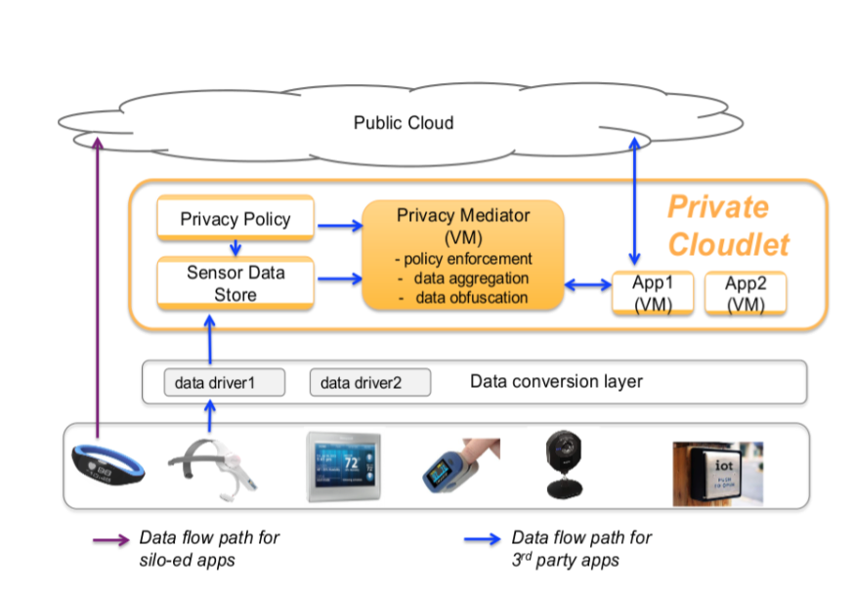

Slide 14
Cloudlets
Key to our architectural approach
Enable cloud services to be virtualized and then instantiated close to their point of use
Approach1: cloudlets are physically installed in homes, schools or small businesses (on a high-end Wi-Fi access point or on a computer in a wiring closet)
Approach2: local telephone companies or cloud service providers host cloudlets on behalf of home owners.
Notes:
在配線間的機架式電腦
Performance studies need to be done to explore these options, but as we show in Section 5.2, a high-end laptop can suffice even for some demanding use cases.
within the trust domain of the end user.

Slide 16
Privacy Mediators (1/2)
Specific to a single class or operate over data produced by different IoT sensors.
Conversion layer: convert data into standard or common formats
Users are able to create policies that control the routing of sensor data to mediators
In addition to filtering outbound data also store local sensor data
→ access control, granularity adjustment, user policy
Notes:
協助實作安控機制的重要元件，在物聯網資料上傳到雲端之前進行
期待mediator可以帶來「過濾」資料之外更多元的作用
基本上 它可以針對單一類別的sensor操作，或是廣泛套用在多種不同sensor上 ex…
因為要能夠處理來自各種sensor的資料，而這些sensor可能因為來自不同製造商、或是感測不同東西所以導致資料格式不同，所以這個架構做了一個conversion layer來整合這些來自不同地方的data
(e.g. video denaturing) being allowed for some apps or services, but not others.
使用者可以簡單地控制自己隱私的權限，比如讓A app全部權限 但B app是denature過後

Slide 17
Privacy Mediators (2/2)
Encapsulation: VM → Docker
Tradeoff : increased memory footprint and processor overhead v.s. superior isolation, safety and smaller attack surface.
Enables dynamic instantiation of mediators for users that outside of their usual home or workplace.
also enables post-mediator application- specific preprocessing of sensor data.
Notes:
However, in a high-trust deployment, a lighter-weight container such as Docker may be used instead of a VM for encapsulation.
solving the scalability problem that metro-area networks will face when their input data rates reach excessive volumes due to the proliferation of video capture devices.

Slide 18
Privacy Mediators (2/2)
Encapsulation: VM → Docker
Tradeoff : increased memory footprint and processor overhead v.s. superior isolation, safety and smaller attack surface.
Enables dynamic instantiation of mediators for users that outside of their usual home or workplace.
also enables post-mediator application- specific preprocessing of sensor data.
Benefits: trust, privacy, performance and scalability (reduced latency and bandwidth)
Notes:
However, in a high-trust deployment, a lighter-weight container such as Docker may be used instead of a VM for encapsulation.
solving the scalability problem that metro-area networks will face when their input data rates reach excessive volumes due to the proliferation of video capture devices.

Slide 19
Mediators & Trust (1/2)
Provider:
mediators produced by the same organizations that supply the sensors and associated cloud services
expect mediators be developed by independent third- parties
open source mediators -- could obtain trusted reputations by subjecting their code to organizations that give out certifications or seals of approval after inspecting and evaluating a product.
Notes:
then there is little for the user to gain in terms of privacy guarantees – they would still have to place total trust in the integrity of these organisations’ solutions
in much the same way as virus checking software is produced today.

Slide 20
Mediators & Trust (1/2)
Minimize the occurrence of privacy incidents
creates a data processing pipeline that sits between third party applications and the raw sensor data.
→ APIs
trust in mediators and cloudlet, rather than hundreds of applications
Notes:
leakage of private data when a service provider is hacked, rogue employees, one company selling data to another who in turn exposes it, communications eavesdropping when insufficient encryption is used [19], or if data gets subpoenaed. Privacy incidents can also occur when a company’s transparency in their privacy policy poorly communicates what data is collected [20].
APIs → they wouldn’t need to implement functionality such as denaturing, data aggregation, and policy enforcement, themselves.

Slide 21
Data Storage
Minimize the threat surface → each mediator maintain its own buffer.
Raw data could be deleted immediately or buffered in the cloudlet
Encrypting and storing raw video sensor data using a randomly-generated private key that is only present within the VM instance (i.e., mediator) for that sensor (Simons et al.).
Notes:
每個mediator僅能存取自己負責的sensor的資料，無法存取所有在cloudlet上，就算遭到攻擊，也可以將傷害降到最低，不去影響到其他mediator期他單元
還有原始資料的應用。因為資料經過mediator，會根據用戶制定的規則轉變成特徵值傳出去，因此原始的資料可以立即被刪除，但是也可以繼續留存在cloudlet中以備不時之需，比如說有小偷闖進家裡需要吊監視器的時候
可以根據需求，透過mediator安全地用隨機生成的私鑰解密

Slide 22
User Policies (1/2)
UbiComp (Ubiquitous Computing)
Myles et al. : location data management
Rei: defined four policy object types: rights, prohibitions, obligations, and dispensations.
Notes:
用戶與mediator溝通的方式
這邊作者提到UbiComp這個名詞，普及計算，是一個強調和環境融為一體的計算概念，電腦本身則從人們的視線裡消失。在普及計算的模式下，人們能夠在任何時間、任何地點、以任何方式進行資訊的擷取與處理。涉及研究範圍很廣，包括分散式計算、行動計算、人機互動、人工智慧、嵌入式系統、感知網路等多方面技術的融合。
Myles: 應用程式提交也包含隱私策略的rq，然後用戶的驗證器會去看這個應用程式所要求的資料是否可以被存取，以及是否需要進行任何轉換、減少數據的粒度。
Rei: 權限（實體完成某項動作要有的許可），禁止（也就是明確指出哪些實體不能存取資料），義務（實體必須執行的操作）以及免除（豁免—免除某些實體的義務）。

Slide 23
User Policies (1/2)
UbiComp (Ubiquitous Computing)
Myles et al. : location data management
→ only applied to location data
Rei: defined four policy object types: rights, prohibitions, obligations, and dispensations.
→ used for security policies
Notes:
對於在物聯網上擴增的應用仍須探究

Slide 24
User Policies (2/2)
Challenges
large volume of deployed services
recipient-specific preferences
Notes:
在擴增時會遇到兩大難題
有太多需要去設定權限的sensor和服務，而每當使用一個新服務就要設定一次權限是一個非常麻煩的做法，直接設定sensor擷取資料的權限會相對容易一些，但還是十分麻煩、有待探究
ex, a home owner may be willing to share detailed data with their energy supplier (for the purpose of improving the provided service or managing billing), but may only wish to share summarizations with a local government or third-party application.

Slide 25
User Policies (2/2)
Challenges
large volume of deployed services
recipient-specific preferences
→ mediator requests
Notes:
除了以mediator 為隱私政策的單位之外，用戶也應該定期維護隱私政策，來因應新的應用程式、新的服務或是根據使用習慣和作息進行調整。
現有的文獻建議以兩種做法提升用戶維護隱私這側的意願

Slide 26
User Policies (2/2)
Challenges
large volume of deployed services
recipient-specific preferences
mediator requests
Maintainence
determine a set of smart default privacy profiles that capture a range of opinions about privacy (Lui et al.)
active privacy assistant
Notes:
除了以mediator 為隱私政策的單位之外，用戶也應該定期維護隱私政策，來因應新的應用程式、新的服務或是根據使用習慣和作息進行調整。
現有的文獻建議以兩種做法提升用戶維護隱私這側的意願
在裝置中找到一組default 隱私設定（大概是4-6項），可以知道用戶通常准許和禁止哪新隱私資料的傳遞。這些文件可捕捉用戶的偏好並允許進行簡單的隱私客製化。用戶只需要在default文件之外發生某些需要隱私授權的事件時進項參與和調整就可以了。
隱私助理，只有在某些需要用戶注意的偶發性事件發生的時候，來建議用戶採取動作。相關調查顯示，當用戶一天只碰到一個隱私問題時，有60%的機率會積極地反應和調整隱私設定

Slide 27
Business Models
Home
Third party, first party.
Large organization
School
More IoT business
Lawyers, hospitals.

Slide 28
Challenging Use Cases
Human Augmentation
Omnipresent Video

Slide 29
Human Augmentation
Fixed infrastructure cameras
Wearables
Over 280GB of data was captured including 42,959 images and 248.15 hours of video and location data.
Cloudlets
Robust, scalable and secure
Provide a natural way
Notes:
人類增強，外骨骼裝甲？
實際上就是加入了大量的可穿戴設備以及固定攝像頭等等，試一下拍兩天要處理多少數據。

Slide 30
Omnipresent Video
Videos everywhere at the same time
Challenges for scalability as well as privacy
You could get details in the other group’s presentation
Denaturizing: privacy and value
Notes:
全在，出現在任何地方的能力

Slide 31
Related Work
Differs from these rule-based intermediaries by offering a generalized cloudlet infrastructure for intercepting both mobile and (predominantly) fixed sensor data.
Focus on processing outgoing sensor streams.
More general support.
Enable send data to cloud at a user-chosen granularity.

Slide 32
Conclusion
Privacy is a key issue
Proposed an architecture based on an essential design principal, namely that users should maintain overall control of their data and be responsible for managing its release to cloud services.
Traditional IoT environments and challenging IoT scenarios
Focus on home because need is most

Slide 33
Thanks!

